Slide 1
S1 Block 2 Test Revision (1)
Given that
$$c=7, d=−3 and e=9$$
Find the values of the following expressions
$$a) 3c−4d$$
$$b) 2de$$
$$c) ce−d^{2}$$

Slide 2
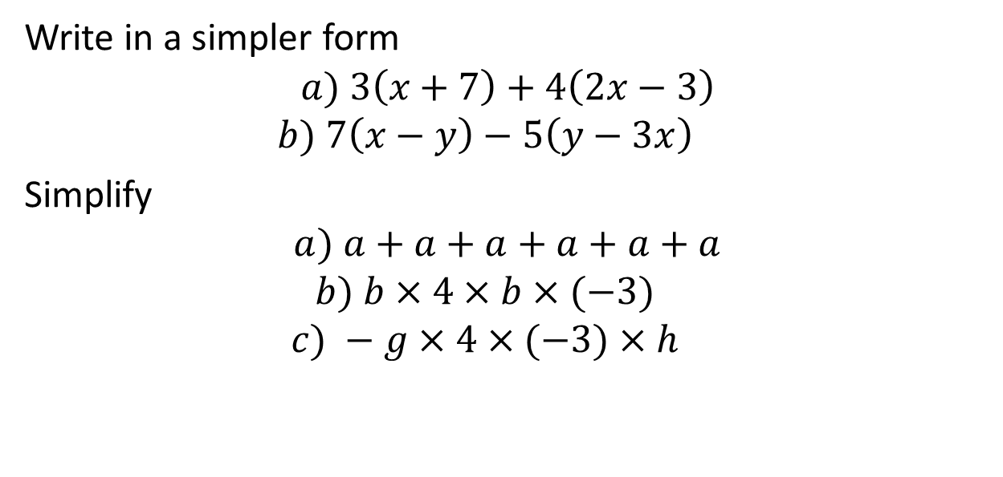
S1 Block 2 Test Revision (2)
Write in a simpler form
$$a) 3\left(x+7\right)+4\left(2x−3\right)$$
$$b) 7\left(x−y\right)−5\left(y−3x\right)$$
Simplify
$$a) a+a+a+a+a+a$$
$$b) b×4×b×(−3)$$
$$c) −g×4×(−3)×h$$

Slide 3
S1 Block 2 Test Revision (3)
Solve the following equations
$$a) 3x+27+x=35$$
$$b) 54−7x=33$$
$$c) 3\left(4x−7\right)=39$$

Slide 4
S1 Block 2 Test Revision (4)
The map shows the distances between 4 towns along the M8.
How far is it from Glasgow to Bathgate (answer in terms of x)
Write down an expression for the distance from Bathgate to Edinburgh
Write an expression for the distance from Livingston to Edinburgh.
Glasgow
Livingston
Bathgate
Edinburgh
5x miles
x miles
48 miles

Slide 5
S1 Block 2 Test Revision (5)
By first rounding each number to one figure accuracy,
estimate the answer for each of these calculations.
234 x 49
727 ÷ 69
345 x 22 + 456 x 12

Slide 6
S1 Block 2 Test Revision (6)
1. The front wheel on Jennie’s tricycle has 12 spokes.
What size is the angle at the centre of the wheel between each spoke?
2. If the outside of the wheel measures 13.2 cm from one spoke to the next, how far is it all the way round the wheel?
3. If Jennie cycles 100 m, how many times will the wheel have turned?

Slide 7
S1 Block 2 Test Revision (7)
1. Emma is a 2oom runner.
During a training session she averages 20.7seconds for 3 runs.
Andrea completes two laps, one in 20.9 seconds, the other in 20.3 seconds. What time must she do in her third run to beat Emma’s total time?
2. Round the following to 1 decimal place
a) 0.921 b) 3.4567 c) 19.9999

Slide 8
S1 Block 2 Test Revision (8)
Calculate the mean, median, mode and range of the following sets of data
1. 3.4 4.8 4.5 4.5 3.9
6.1 4.8 4.8 5.1 3.7
2. -2 7 5 3 -2

Slide 9
S1 Block 2 Test Revision (9)
Copy the diagram and fill in all the missing angles
Calculate the size of the
interior angle of this regular
octagon.
32°

